Slide 1
Analog and Digital signals

Slide 2
An electrical or electromagnetic quantity (current, voltage, radio wave, micro wave, etc.) that carries data or information from one system (or network) to another is called a signal.
wo basic types of signals are used for carrying data, viz. analog signal and digital signal.
One major difference between the two signals is that an analog signal is a continuous function of time, whereas a digital signal is a discrete function of time.

Slide 3
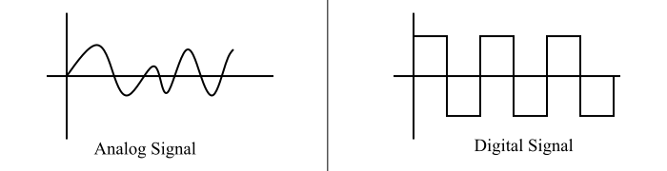

Slide 4
Difference between Analog and Digital Signal
Analog signals use a continuous range of values to represent the data and information. Digital signals use discrete values (or discontinuous values), i.e. discrete 0 and 1, to represent the data and information.
The analog signals are more suitable for transmission of audio, video and other information through the communication channels. The digital signals are suitable for computing and digital electronic operations such as data storage, etc.
Analog signals get affected by the electronic noise easily. The digital signals are more stable and less susceptible to noise than the analog signals.

Slide 5
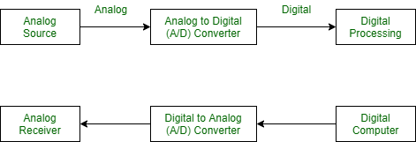
Transmission of digital signal

Slide 6
Analog-to-Digital Conversion
Microphones create analog voice and camera creates analog videos, which are treated is analog data.
To transmit this analog data over digital signals, we need analog to digital conversion.
Analog data is a continuous stream of data in the wave form whereas digital data is discrete.
To convert analog wave into digital data, we use Pulse Code Modulation (PCM).

Slide 7
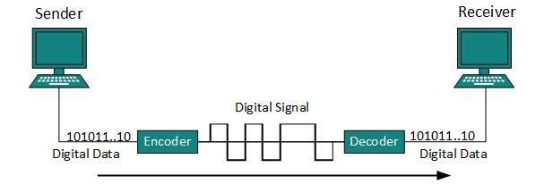
Digital Transmission in Computer Network
Digital-to-Digital Conversion-LINE coding technique

Slide 8
Transmission Impairments in computer networks
Transmission impairment occurs when the received signal is different from the transmitted signal.
There are various causes of transmission impairments −
Noise
Distortion
Attenuation

Slide 9
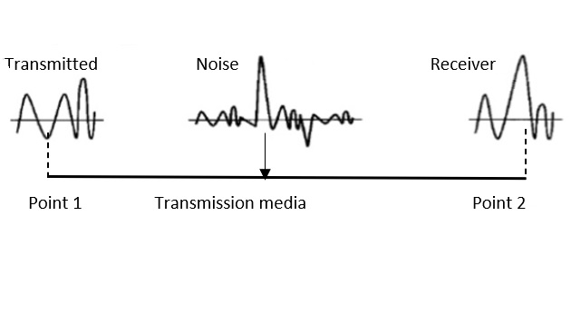
Noise

Slide 10
Noise
Noise is the major factor for the transmission distortion as any unwanted signal gets added to the transmitted signal by which the resulting transmitted signal gets modified and at the receiver side it is difficult to remove the unwanted noise signal. These noises are various kinds like shot noise, impulse noise, thermal noise etc.

Slide 11
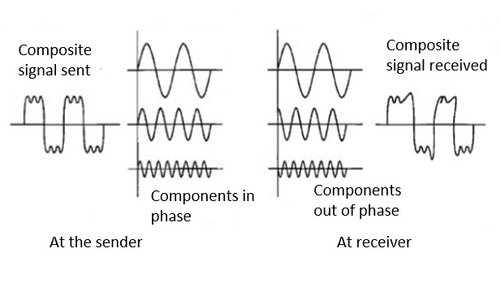
Distortion

Slide 12
Distortion
This kind of distortion is mainly appearing in case of composite signals in which a composite signal has various frequency components in it and each frequency component has some time constraint which makes a complete signal.
But while transmitting this composite signal, if a certain delay happens between the frequencies components, then there may be the chance that the frequency component will reach the receiver end with a different delay constraint from its original which leads to the change in shape of the signal.
The delay happens due to environmental parameters or from the distance between transmitter and receiver etc.

Slide 13

Attenuation

Slide 14
Attenuation
Attenuation is generally decreased in signal strength, by which the received signal will be difficult to receive at the receiver end. This attenuation happens due to the majority factor by environment as environment imposes a lot of resistance and the signal strength decreases as it tries to overcome the resistance imposed.

Slide 15
Parameters for Measuring Network Performance
BAND WIDTH
LATENCY
THROUHPUT
Bandwidth is characterized as the measure of data or information that can be transmitted in a fixed measure of time.
The term can be used in two different contexts with two distinctive estimating values.
In the case of digital devices, the bandwidth is measured in bits per second(bps) or bytes per second.
In the case of analog devices, the bandwidth is measured in cycles per second, or Hertz (Hz).

Slide 16
LATENCY
In a network, during the process of data communication, latency(also known as delay) is defined as the total time taken for a complete message to arrive at the destination, starting with the time when the first bit of the message is sent out from the source and ending with the time when the last bit of the message is delivered at the destination.
The network connections where small delays occur are called “Low-Latency-Networks” and the network connections which suffer from long delays are known as “High-Latency-Networks”.

Slide 17
Propagation Time
It is the time required for a bit to travel from the source to the destination.
Propagation time can be calculated as the ratio between the link length (distance) and the propagation speed over the communicating medium.
For example, for an electric signal, propagation time is the time taken for the signal to travel through a wire.
THROUGHPUT
Throughput is the number of messages successfully transmitted per unit time

